Slide 1




DESIGN AND IMPLEMENATION OF AN
E-VOTING SYSTEM USING BLOCKCHAIN AND FACIAL RECOGNITION
BY
ADEKUNLE ESTHER TEMITOPE
SSE/017/18609
SUPERVISOR
DR. A.O IBITOYE
AUGUST 2021

Slide 2
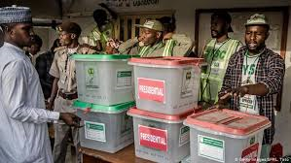


INTRODUCTION
Voting is also crucial event that determines the fate of a nation, hence, providing adequate and tight security measures to ensure free and fair voting is very important.
In today’s democracy, elections are very important but citizens of their country do not trust their election process which is a major concern to the country.
Notes:
大专院校延期开学防疫工作安排

Slide 3

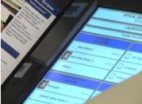
METHODS OF VOTING
Traditional system: The idea of paper ballots was allowing voters to determine their vote by the marking tools (i.e. pen, pencil)
Internet voting can conduct in many ways like web platform, email, fax etc
Notes:
大专院校延期开学防疫工作安排

Slide 4
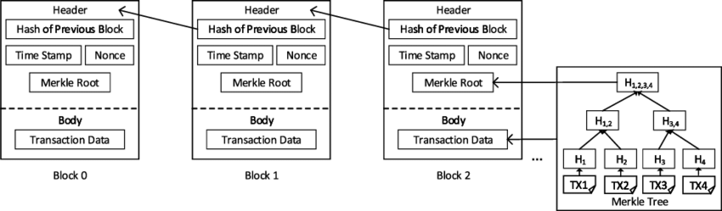
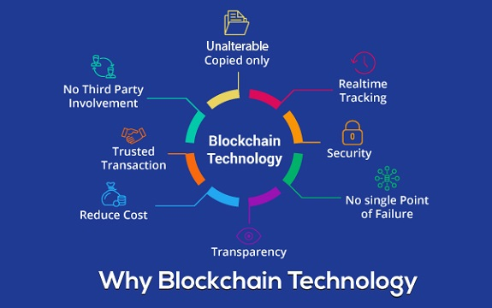
Blockchain can be defined as a chain of blocks and each new block keeps the hash of the previous block information.
A facial recognition system is a technology capable of matching a human face from a digital image or a video frame against a database of faces.
Notes:
大专院校延期开学防疫工作安排

Slide 5

LITERATURE REVIEW
TITLE | AUTHOR | METHODS
Online Voting: Voting System Using Blockchain | Albin benny et al. | Cryptographic verification and homomorphic encryption technique.
Blockchain Technology for Electronic Voting | Ong Kang Yi, Debashish Das, 2020. | Use of Public Permissioned Blockchain and Smart Contracts.
A Study on Decentralized E-Voting System Using Blockchain Technology | Harsha V. Patil et al, 2018. | Decentralized networks for casting and recording of votes.
Decentralized Electronic Voting System based on Blockchain Technology | Kateryna Isirova et al, 2020. | Use of two intersecting blockchain networks for voters identification and vote casting and results.
Notes:
大专院校延期开学防疫工作安排

Slide 6

/
PROBLEM STATEMENT
The existing system of voting is faced with the problem of impersonation as long as a voter has the log in details of another voter.
Notes:
大专院校延期开学防疫工作安排

Slide 7

AIM
The aim of this project is to design an electronic voting system using Blockchain technology for voting activities and facial recognition for authentication.

Slide 8
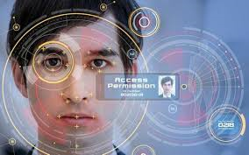
OBJECTIVES
To create a smart contract that is deployed on the ethereum network.
To develop a front-end application that allows user voter votes over the internet
To integrate a facial recognition software for authentication.
.
Notes:
大专院校延期开学防疫工作安排

Slide 9
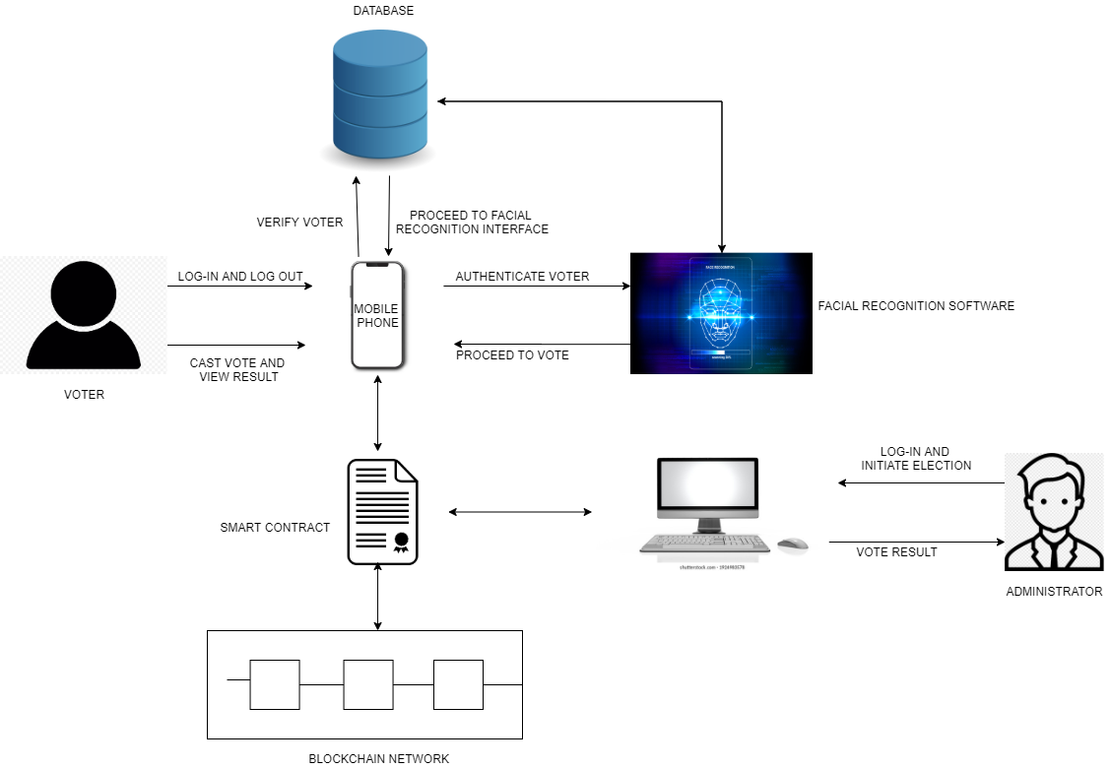
PROPOSED METHODOLOGY
Notes:
大专院校延期开学防疫工作安排

Slide 10
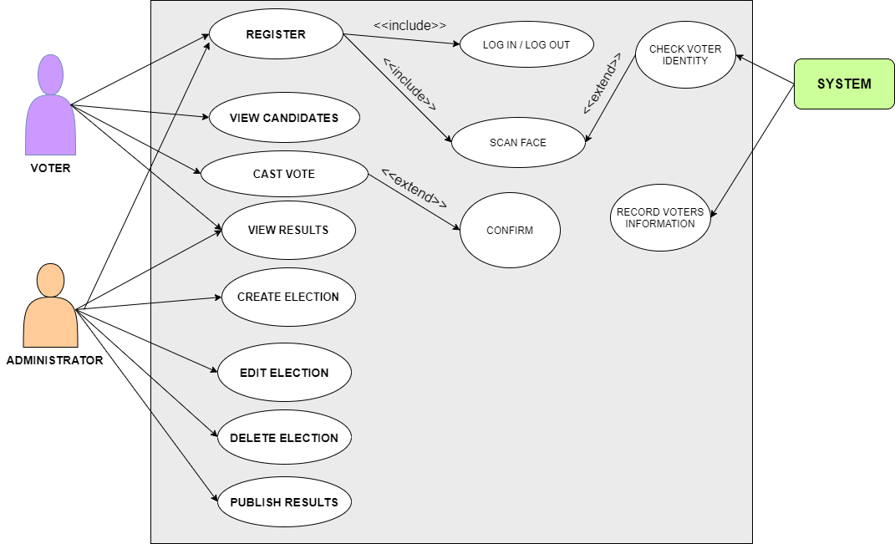
USE CASE DIAGRAM
Notes:
大专院校延期开学防疫工作安排

Slide 11
GENERAL OVEREW OF THE SYSTEM
GENERAL WORKING OF THE SYSTEM
Hardware Requirements.
A laptop or desktop computer (Preferably 64bit)
Random Access Memory (RAM): 8 GB Minimum
Processor: Intel Core i5, 2.4 GHz Minimum
Software Requirements
Windows Operating System (8/10)
Visual Studio Code
Webstorm
Flutter
Genache
Notes:
大专院校延期开学防疫工作安排

Slide 12

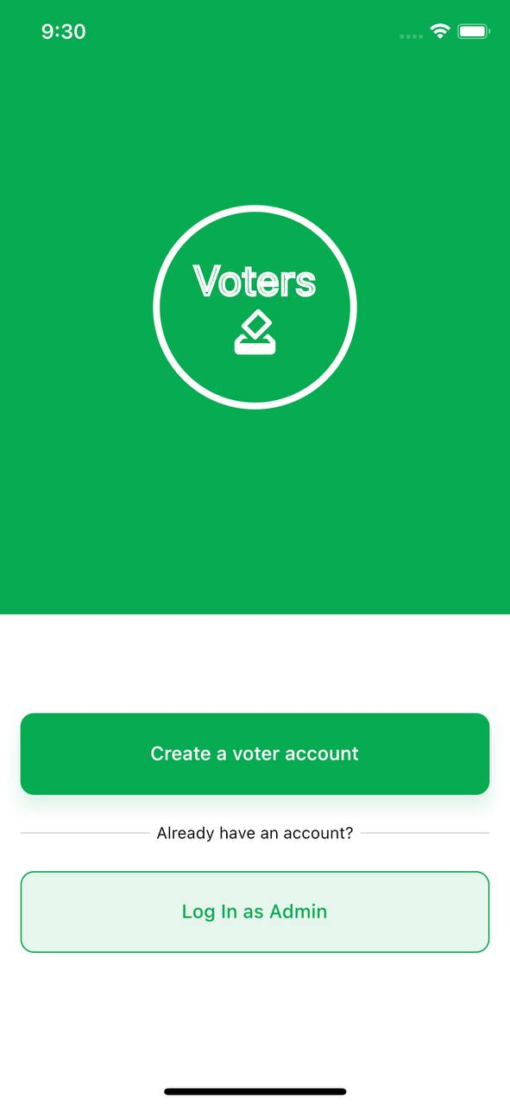
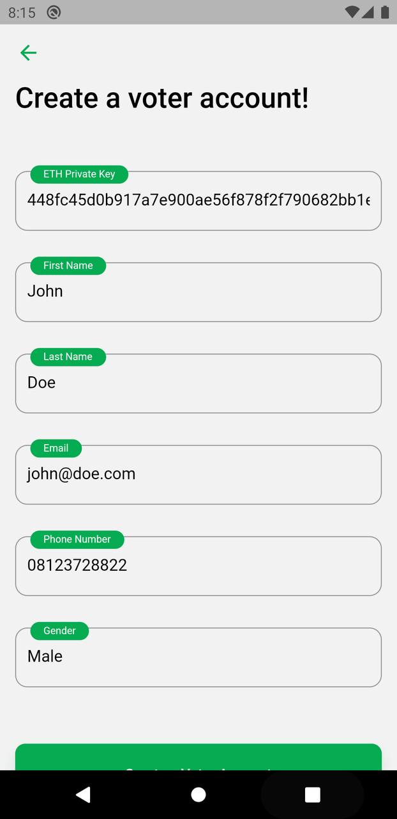
GENERAL OVEREW OF THE SYSTEM
GENERAL WORKING OF THE SYSTEM
SPLASH SCREEN
GET STARTED SCREEN
REGISTER SCREEN
Notes:
大专院校延期开学防疫工作安排

Slide 13
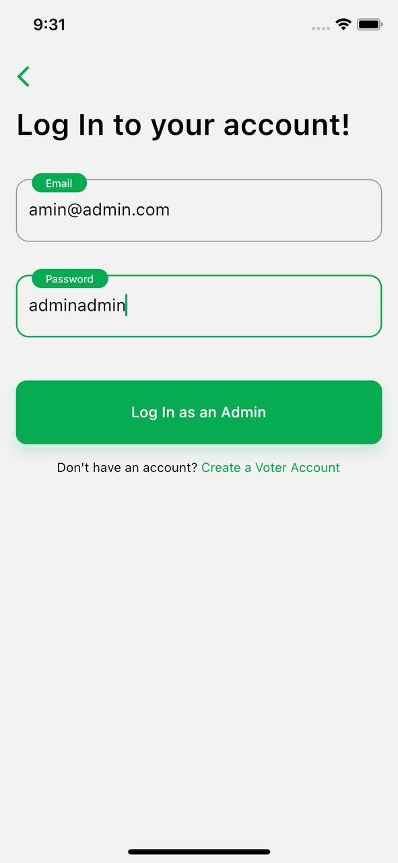
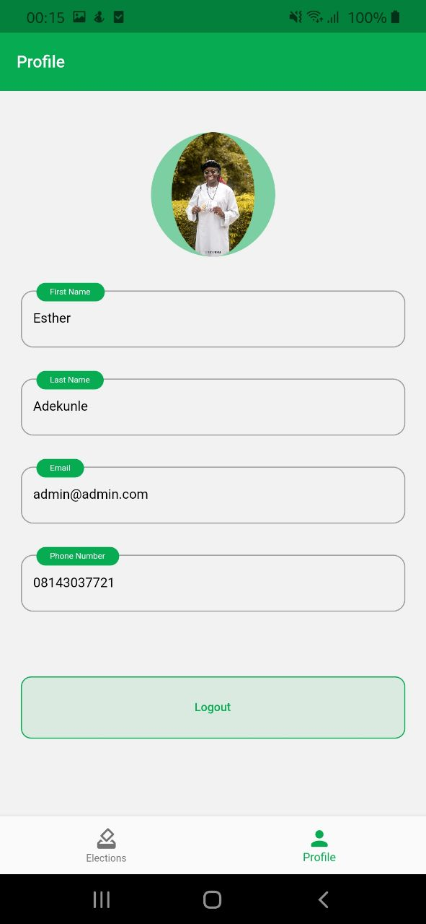
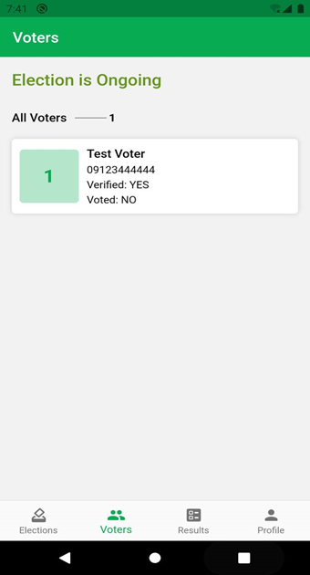
AAAGF
ADMIN SCREEN
ADMIN PROFILE PAGE
ADMIN VOTERS SCEEN
Notes:
大专院校延期开学防疫工作安排

Slide 14
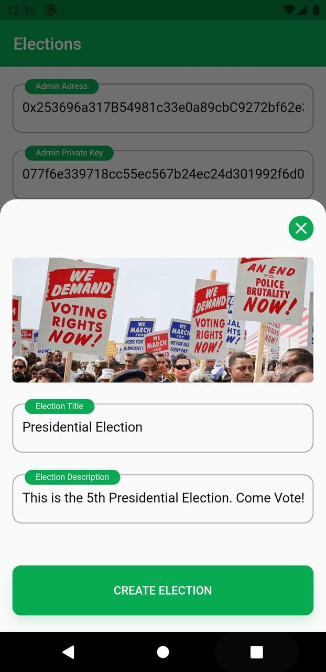

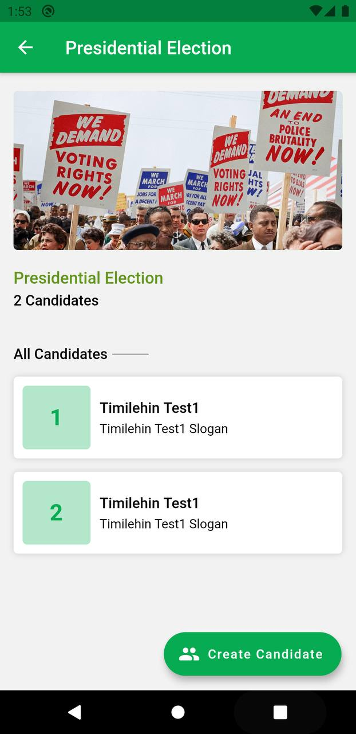
CREATE ELECTION
CREATE CANDIDATE
CANDIDATES SCREEN
Notes:
大专院校延期开学防疫工作安排

Slide 15
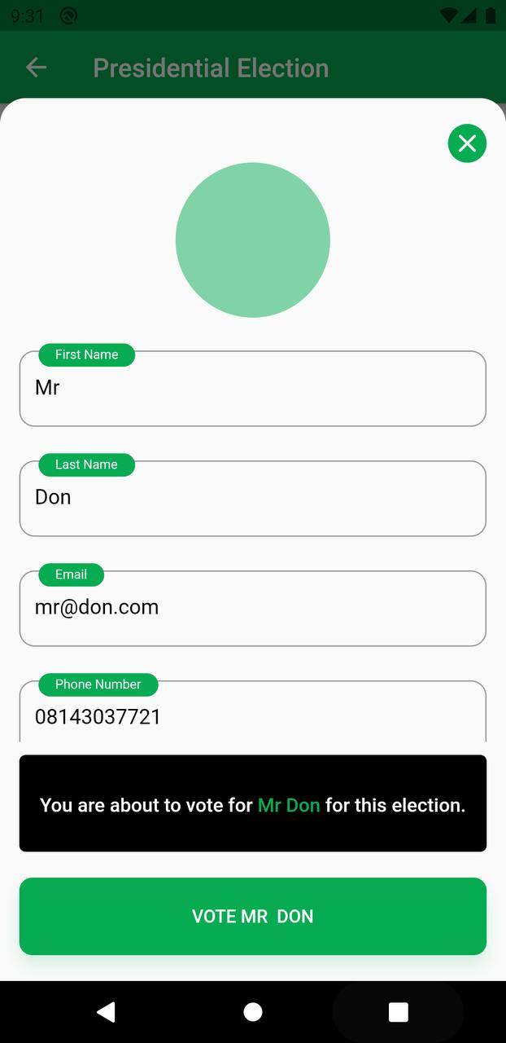
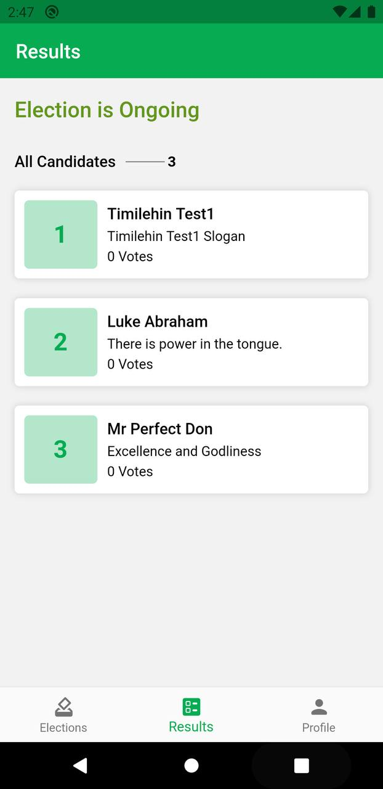
VOTING SCREEN
RESULT SCREEN
Notes:
大专院校延期开学防疫工作安排

Slide 16

CONTRIBUTION TO KNOWLEGDE
It will give the Electoral Commission a way to organize elections that are less expensive and more fair.
Data and information are safeguarded ensuring credible elections.
Reduces the workload throughout the election process.
Integration of remote voting.
Remove illegitimate votes and reduce election violence.
Notes:
大专院校延期开学防疫工作安排

Slide 17
CONCLUSION
With this proposed system, It shows the efficient and effective ways citizens can vote for their desired candidates from the comfort of their homes. It also increases voter’s participation because the election cannot be manipulated by a person impersonating another person the election of a country because of the transparent process ensuring a free and fair election.
Notes:
大专院校延期开学防疫工作安排

Slide 18

LIMITATIONS
The limitations of this system are Politician who benefit from rigging and manipulation of election would reject this system and lack of digital user skills can hinder the adoption by the public.
Notes:
大专院校延期开学防疫工作安排

Slide 19
REFERENCES
Mrs. Harsha V. Patil, Mrs. Kanchan G. Rathi, Mrs. Malati V.Tribhuwan A Study on Decentralized E-Voting System Using Blockchain Technology, 2018
Miss. Komal Kundan Sharma, Prof. Mrunalinee Patole, Prof. Vina M. Lomte, Securing Voting System using Blockchain and Fingerprint Verification, 2019
Nir Kshetri, Jeffrey VoasBlockchain-Enabled E-Voting, 0740- 7459/18/33.00 2018 IEEE
Ali Kaan Koc, Emre Yavuz, Umut Can Cabuk, Gokhan Dalkoloc ”To- wards Secure E-Voting Using Ethereum Blockchain”, 978-1-5386-3449- 3/18/31.00 2018IEEE.
C.D. Clack, V.A. Bakshi, and L. Braine, Smart contract templates: foundations, design landscape and research directions, Mar 2017, arXiv:1608.00771.
F. Hao and P.Y.A. Ryan, Real-World Electronic Voting: Design, Analysis and Deployment, CRC Press, pp. 143-170,2017.
P. McCorry, S.F. Shahandashti, and F. Hao, ”A smart contract for board- room voting with maximum voter privacy”, International Conference on Financial Cryptography and Data Security.Springer, Cham, pp. 357-375, 2017.
Notes:
大专院校延期开学防疫工作安排

Slide 20


